Slide 1

App Flowchart

Slide 2
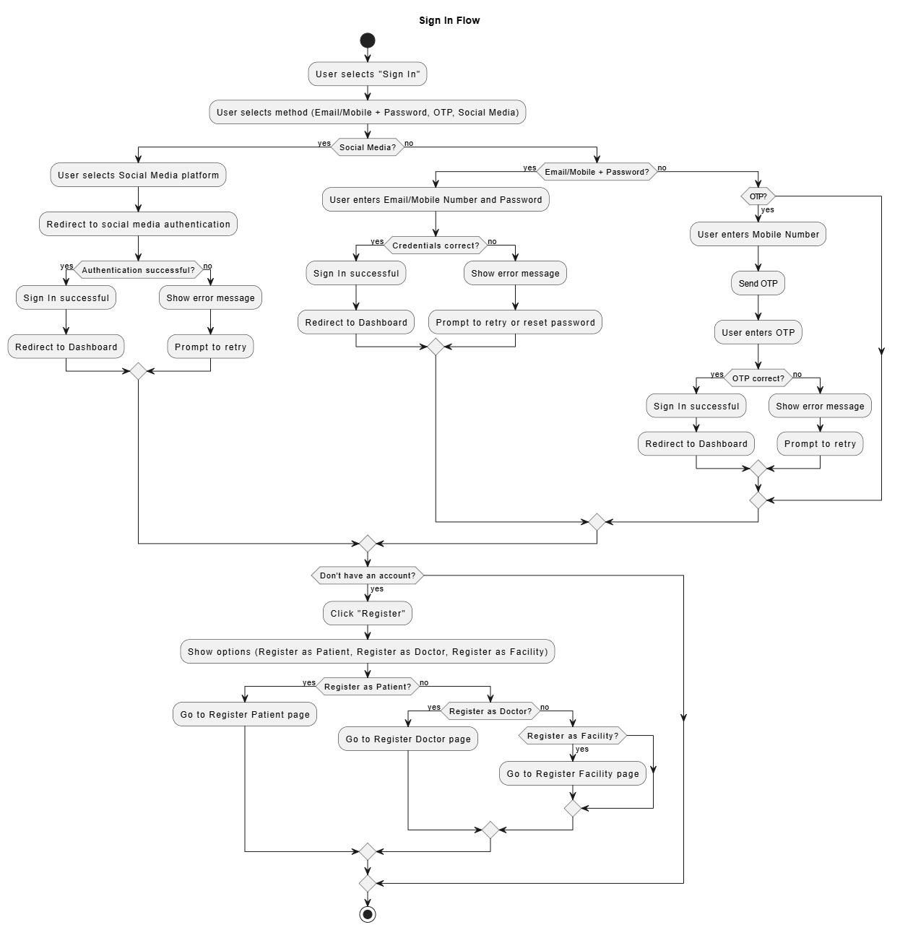
Sign-In Process Using Local Account, Social Media Account and OTP

Slide 3
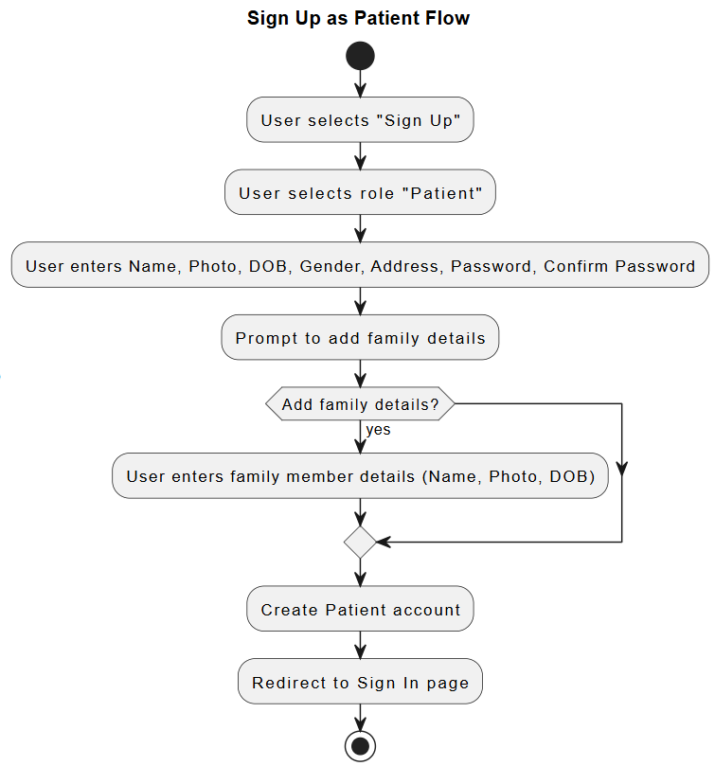
Sign-Up as Patient
No

Slide 4
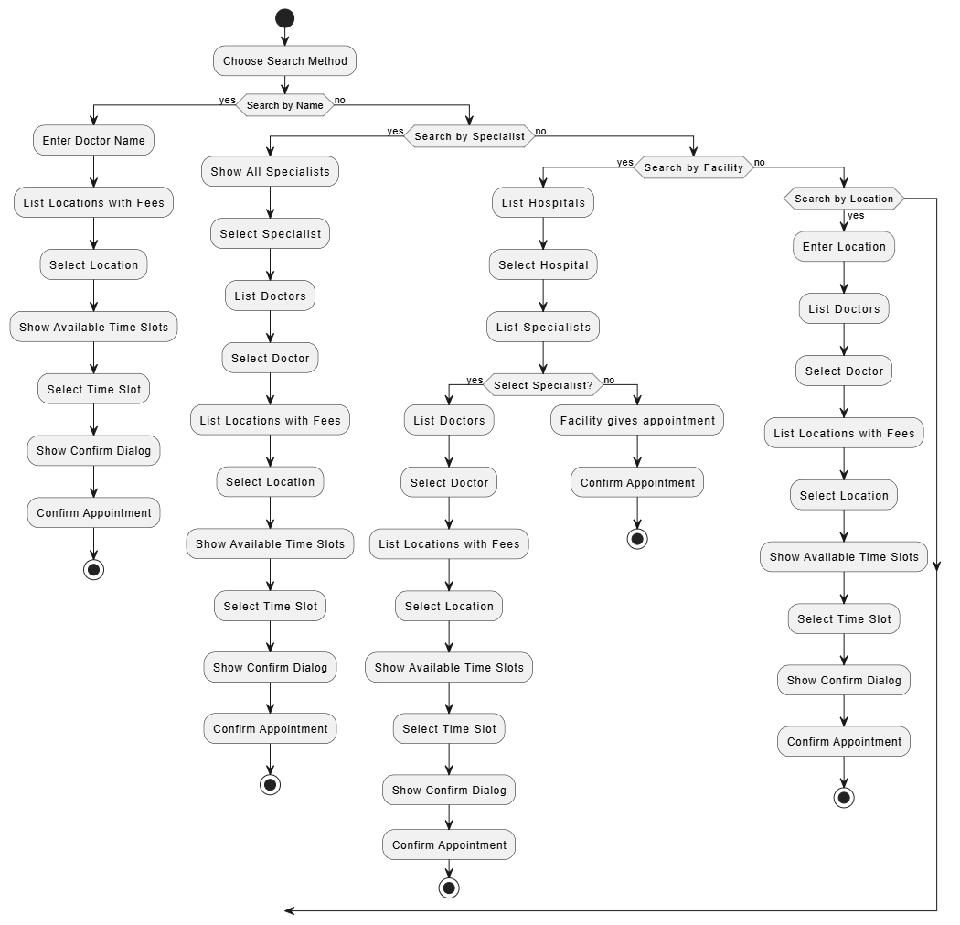
Patient Dashboard
S

Slide 5
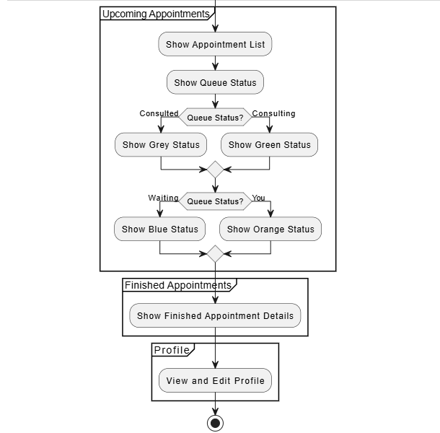
Patient dashboard – Contd..,

Slide 6
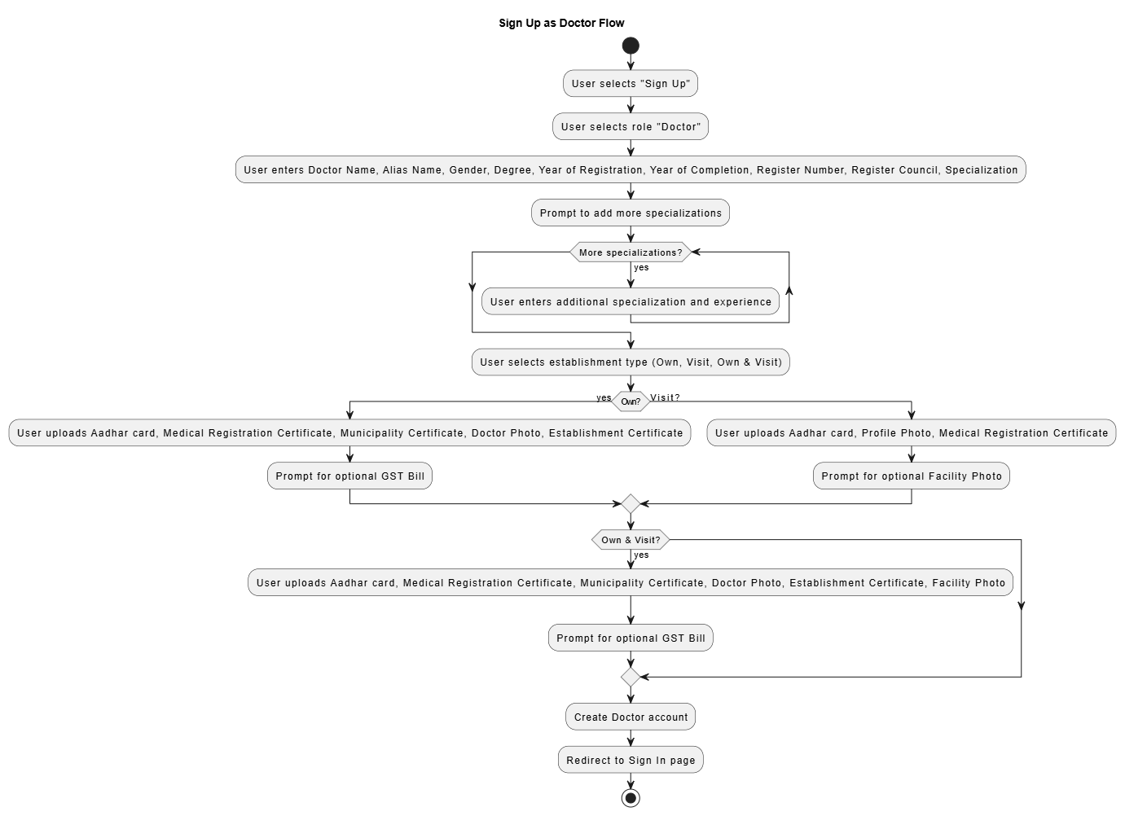
Sign-Up as Doctor

Slide 7
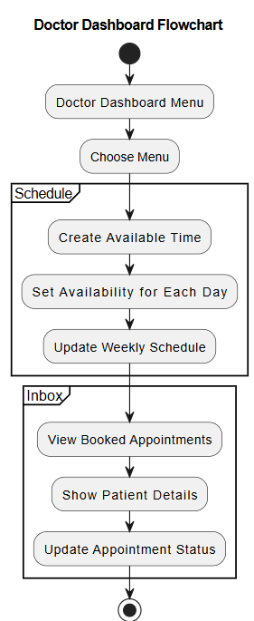
Doctor Dashboard

Slide 8
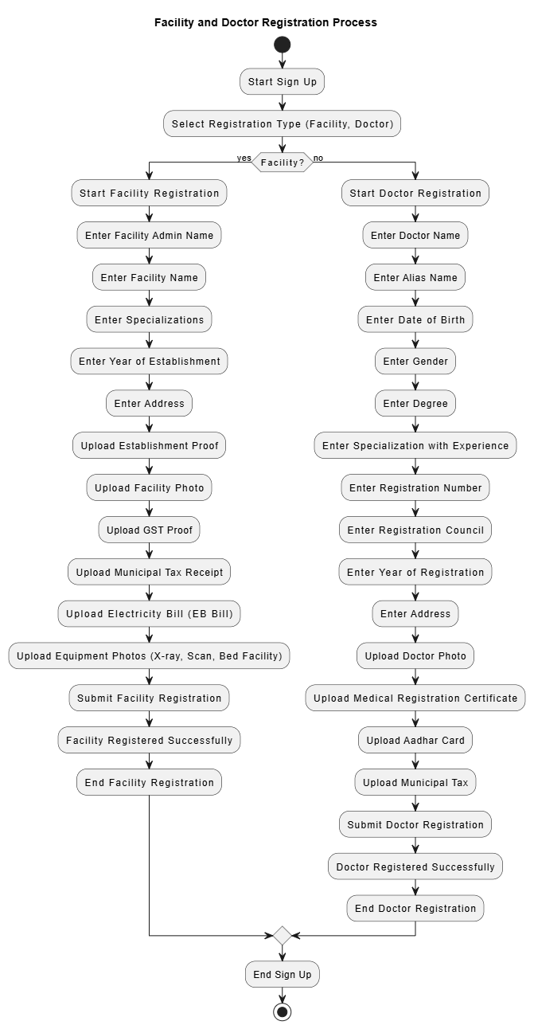
Sign-Up as Facility

Slide 9
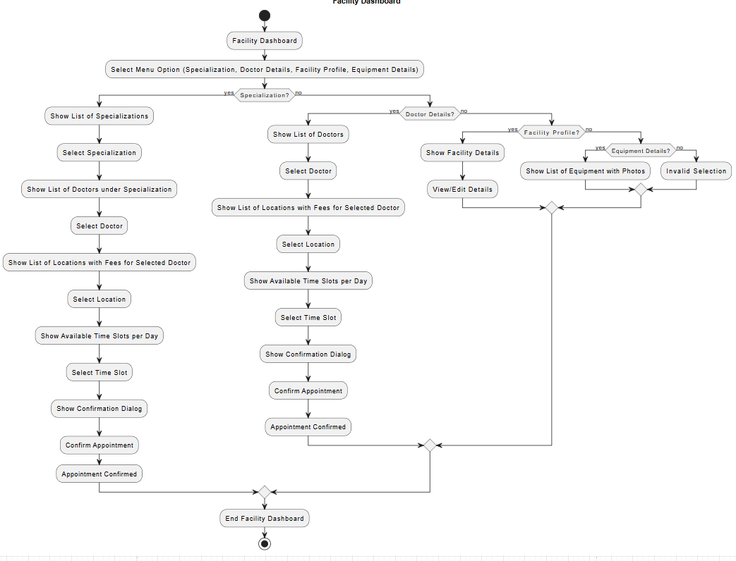
Facility Dashboard

Slide 10
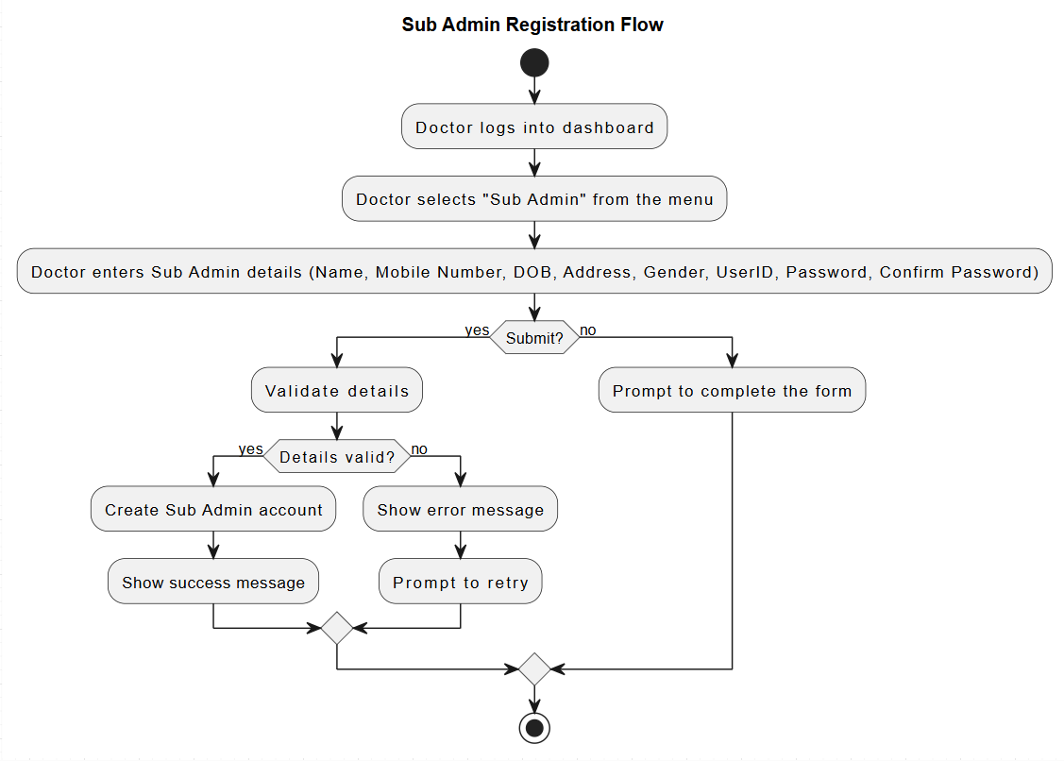
Sub – Admin Registration

